Slide 1
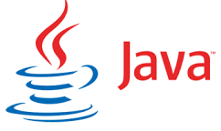




Complete Selenium Automation Engineer Bootcamp: Go from Zero to Hero

Slide 2
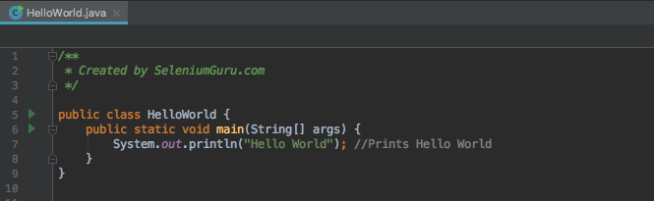
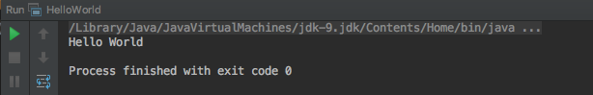
Hello World

Slide 3
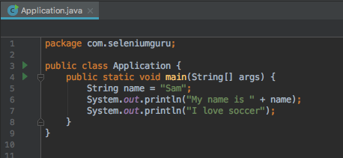
String
String is an object typically representing sequence of characters.
The java.lang.String class is used to create string object.
String are always in double quotes.

Slide 4
Primitive Data Types
Java have basically eight primitive data types.
Byte - The byte data type is an 8-bit signed two's complement integer. It has a minimum value of -128 and a maximum value of 127. The byte data type can be useful for saving memory in large arrays, where the memory savings actually matters.
Short - The short data type is a 16-bit signed two's complement integer. It has a minimum value of -32,768 and a maximum value of 32,767. You can use a short to save memory in large arrays, in situations where the memory savings actually matters.
Int – 2-bit signed two's complement integer, which has a minimum value of -2³¹and a maximum value of 2³¹-1. Int data type is normally used in Java to support arithmetic operation for integers.

Slide 5
Primitive Data Types
Long- The long data type is a 64-bit two's complement integer. The signed long has a minimum value of -2⁶³ and a maximum value of 2⁶³-1. Use this data type when you need a range of values wider than those provided by int.
Float- Float data type is a single-precision 32-bit floating integers. As with the recommendations for byte and short, use a float (instead of double) if you need to save memory in large arrays of floating point numbers.
Double– The double data type is a double-precision 64-bit floating point. For decimal values, this data type is generally the default choice.
Boolean: The boolean data type has only two possible values: true and false. Use this data type for simple flags that track true/false conditions.
Char - The char data type is a single 16-bit Unicode character. It has a minimum value of '\u0000' (or 0) and a maximum value of '\uffff’. Char should be always in single quote.

Slide 6
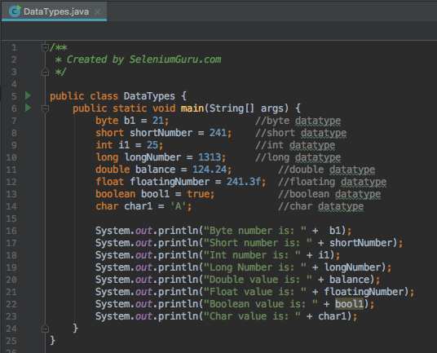
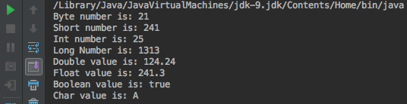
Data Types

Slide 7
Complete Selenium Automation Engineer Bootcamp: Go from Zero to Hero

Slide 8
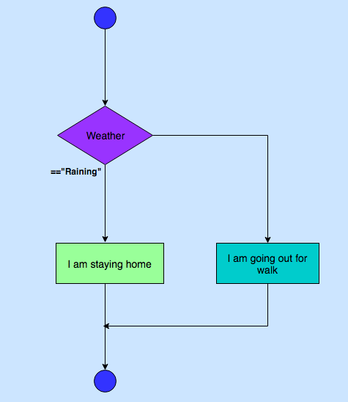
Conditional Execution – If-else

Slide 9
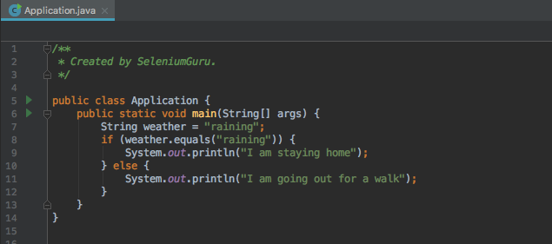
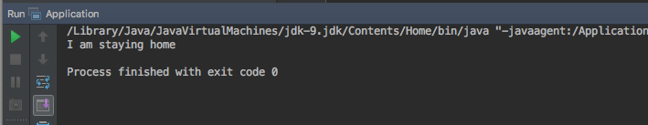
Conditional Execution – If-else

Slide 10
Complete Selenium Automation Engineer Bootcamp: Go from Zero to Hero

Slide 11
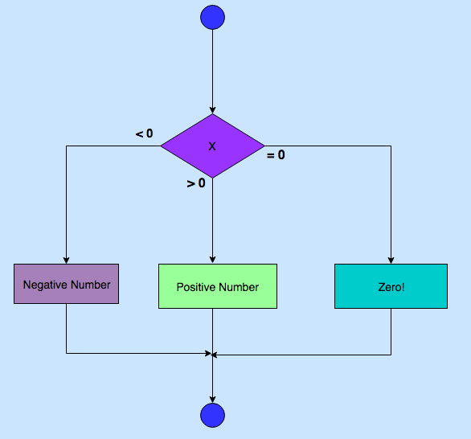
Conditional Execution – If - else if- else

Slide 12
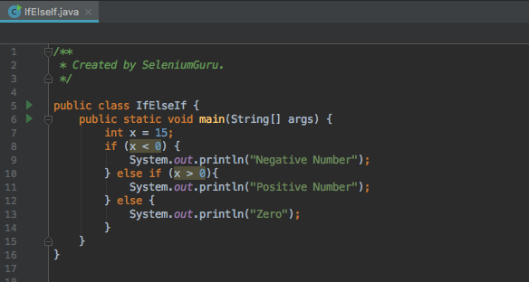
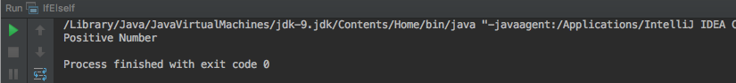
Conditional Execution – If-else-If

Slide 13
Complete Selenium Automation Engineer Bootcamp: Go from Zero to Hero

Slide 14
Conditional Expressions
 | Condition1 | Condition2 | Result
&& | True | True | True
&& | True | False | False
&& | False | True | False
||(OR) | True | False | True
||(OR) | False | True | True
== | Equal to
!= | Not Equal to

Slide 15
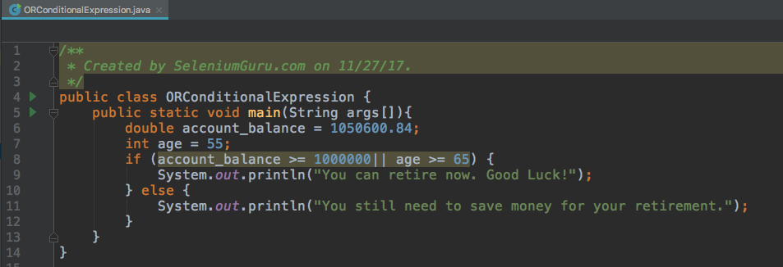
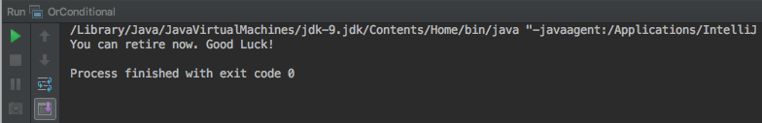
Conditional Expressions

Slide 16
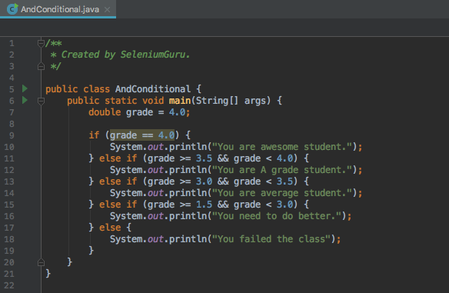
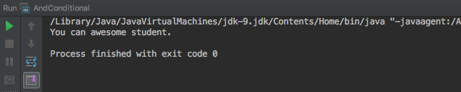
Conditional Expressions

Slide 17
Complete Selenium Automation Engineer Bootcamp: Go from Zero to Hero

Slide 18
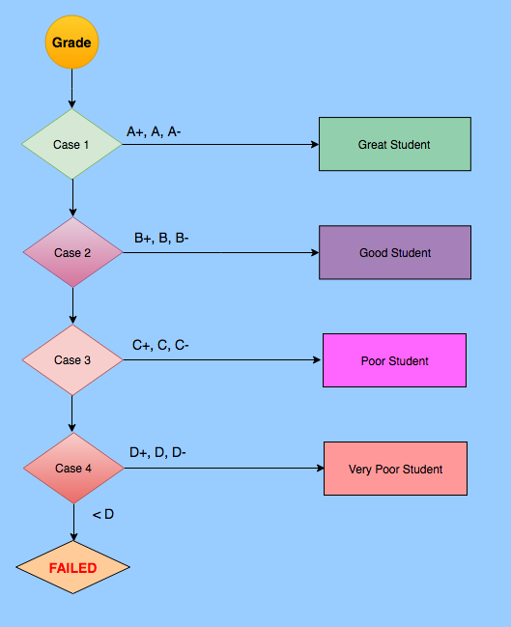
Conditional Execution – Case(Switch)

Slide 19
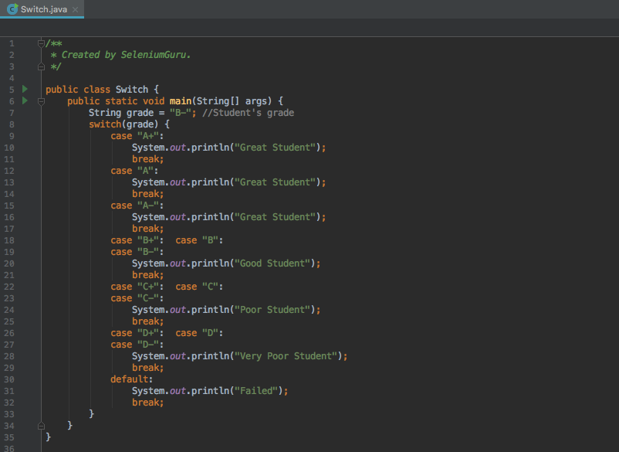
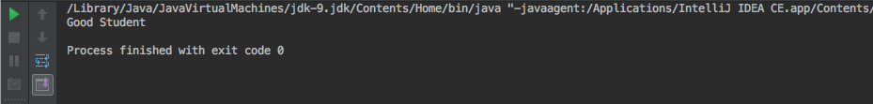
Switch

Slide 20
Complete Selenium Automation Engineer Bootcamp: Go from Zero to Hero

Slide 21
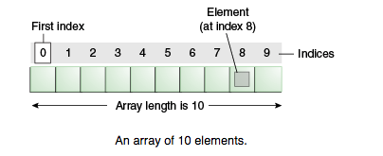
Array
Arrays are ordered, integer-indexed collections of any object.
Arrays are always in curly brackets {}.
Arrays indexing starts at 0 just like in C or Ruby.

Slide 22
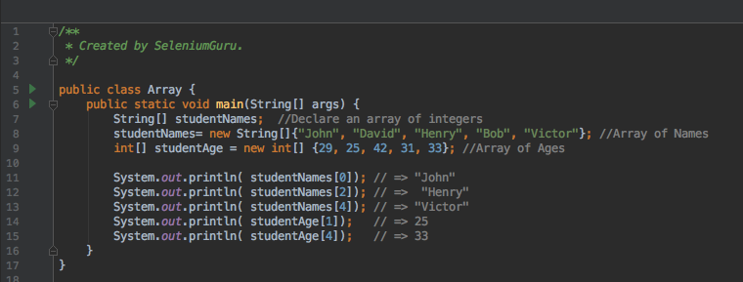
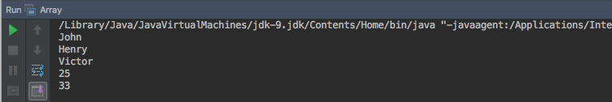
Arrays

Slide 23
Complete Selenium Automation Engineer Bootcamp: Go from Zero to Hero

Slide 24
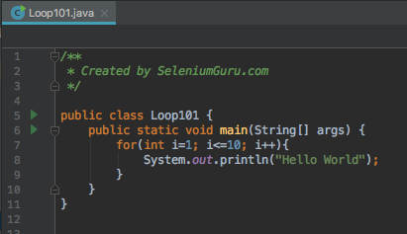
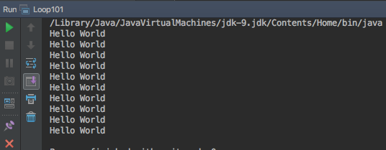
Looping
A loop is a sequence of instructions that is continually repeated until a certain condition is reached.
Looping is used to iterate over the range of number, text, array elements and so on..
Problem: Print “Hello World”10 times.
Without Loop
System.out.println("Hello World"); System.out.println("Hello World"); System.out.println("Hello World"); System.out.println("Hello World"); System.out.println("Hello World"); System.out.println("Hello World"); System.out.println("Hello World"); System.out.println("Hello World"); System.out.println("Hello World"); System.out.println("Hello World");

Slide 25
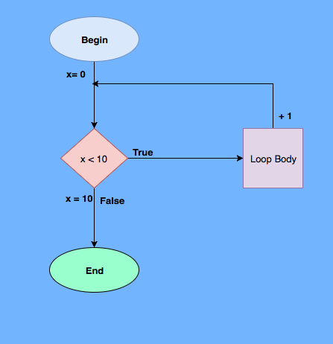
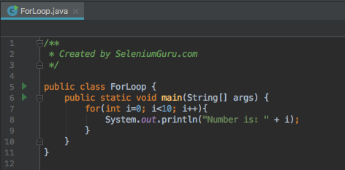
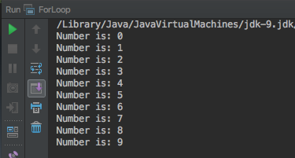
Looping – For Loop

Slide 26
Complete Selenium Automation Engineer Bootcamp: Go from Zero to Hero

Slide 27
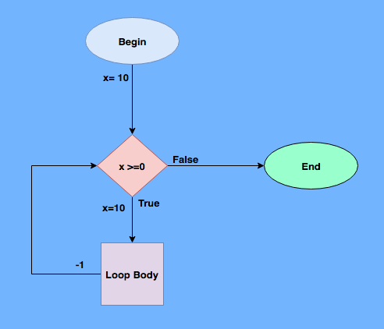
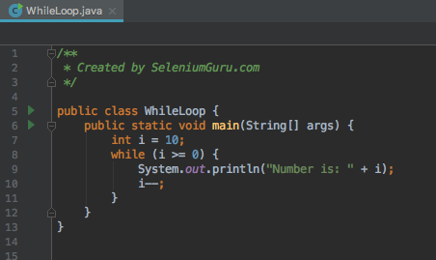
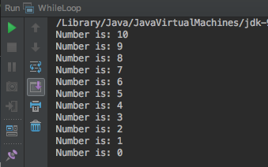
Looping – While Loop

Slide 28
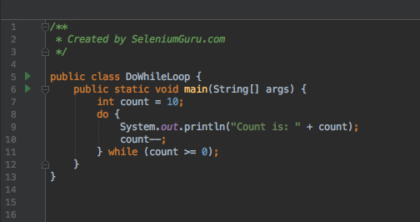
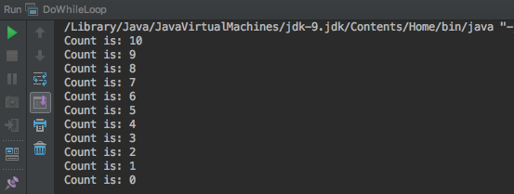
Looping – Do-While Loop

Slide 29
Complete Selenium Automation Engineer Bootcamp: Go from Zero to Hero

Slide 30
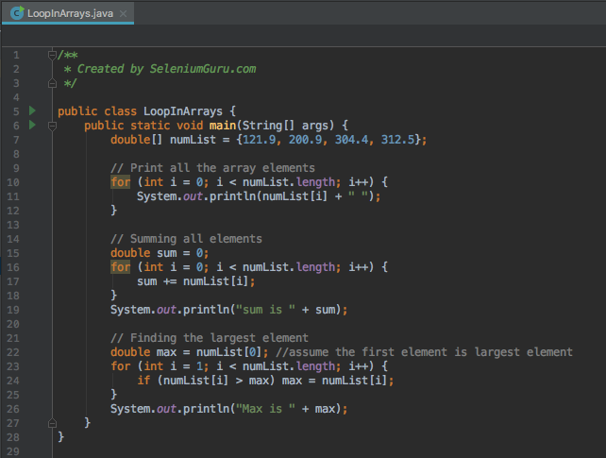
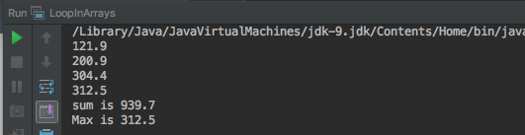
Looping – Arrays

Slide 31
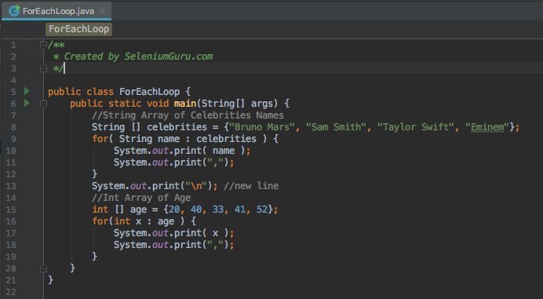
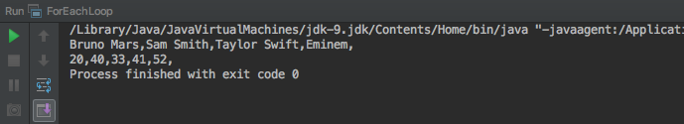
Looping – ForEach

Slide 32
Complete Selenium Automation Engineer Bootcamp: Go from Zero to Hero

Slide 33
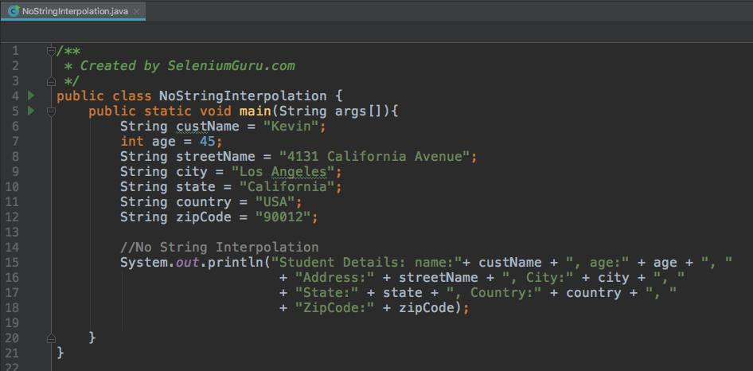
String Interpolation

Slide 34
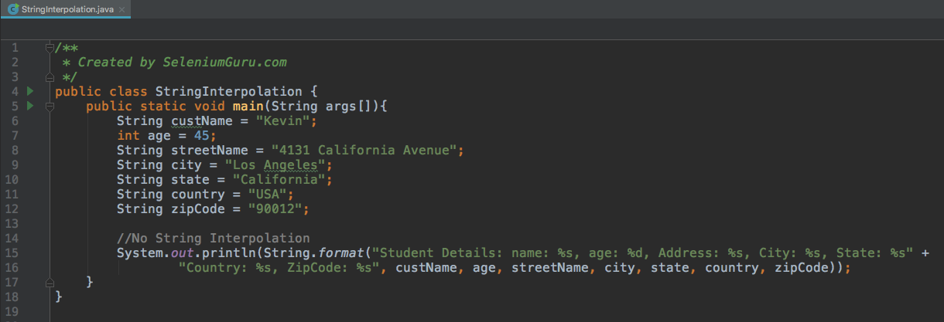
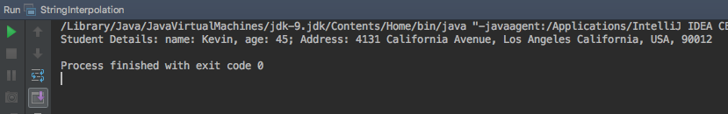
String Interpolation

Slide 35
Complete Selenium Automation Engineer Bootcamp: Go from Zero to Hero

Slide 36
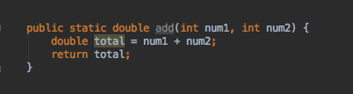
Methods
Methods are collection of statements grouped together to perform an operation.
Methods are used to bundle one or more repeatable statements into a single unit.
Methods are very similar to functions in any other programming language.
Example:
System.out.println(3 + 2) = 5
System.out.println(4 + 5) = 9
System.out.println(12 + 12) = 44
public static = access modifier
double = return type
add = method name
num1 = int parameter1
num2 = int paramter2

Slide 37
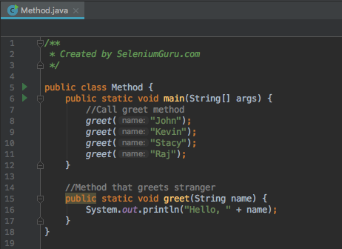
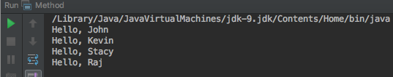
Methods with Return Types – Void(No return)

Slide 38
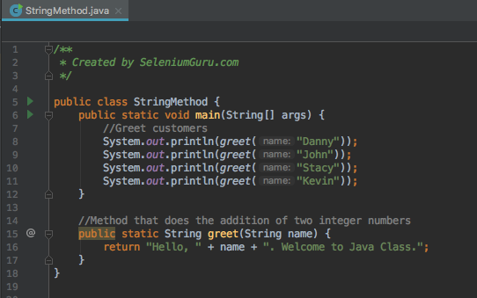
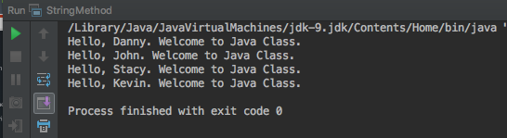
Methods with Return Types- String

Slide 39
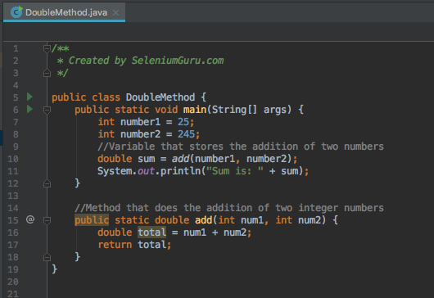
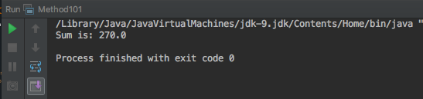
Methods with Return Types - Double

Slide 40
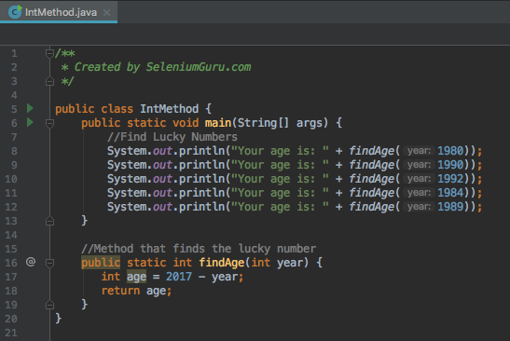
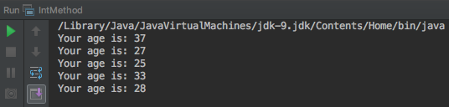
Methods with Return Types- Int

Slide 41
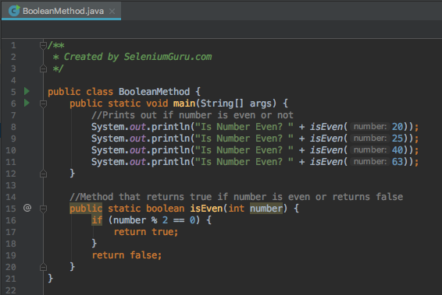
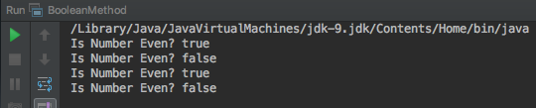
Methods with Return Types - Boolean

Slide 42
Complete Selenium Automation Engineer Bootcamp: Go from Zero to Hero

Slide 43
Classes
Class is a specification or a blue print (set of instructions) of how to provide some service.
Like Blueprint, Class has some exact specifications.
Many Objects can be created from the same class.
Classes can contain methods, variables for an object.
A class can have subclasses that can inherit all or some of the characteristics of the class.
Subclasses can also define their own methods and variables that are not part of their superclass.
Example:
Animal – Dog, Cat, Giraffe, Monkey
Vehicle – Car, Bicycle, Motorbike, SUV
Ford – Focus, F-150, Mustang, Explorer, Fiesta
Dog – Corgi, German Shepherd, Labrador
Honda – Accord, Civic, Pilot, CR-V

Slide 44



Classes Contd..

Slide 45
Complete Selenium Automation Engineer Bootcamp: Go from Zero to Hero

Slide 46


Types of Method: Static Method
Static Method: Methods that can be called and executed without creating an object or instantiation of the main class.
Can be invoked directly via class name.

Slide 47
Complete Selenium Automation Engineer Bootcamp: Go from Zero to Hero

Slide 48


Types of Method: Instance Method
Instance Method: Methods that are called after instantiation of class or object creation.
It is the most Commonly used method type.

Slide 49
Complete Selenium Automation Engineer Bootcamp: Go from Zero to Hero

Slide 50

Types of Method: Constructor Method
Constructor Method: Default method of the class that will be run at the time when the object is created or instantiated.
Constructor method is used to declare default behavior for all objects.
Constructor name must be same as its class name.
Constructor must have no explicit return type.
There are two types of constructors:
Default constructor (no-arg constructor)
Parameterized constructor

Slide 51


Types of Method: Constructor Method

Slide 52


Types of Method: Constructor methods(parameters)

Slide 53
Complete Selenium Automation Engineer Bootcamp: Go from Zero to Hero

Slide 54
Types of Method: Accessor (Getter) Method
Accessor Method: Accessor methods provide access to an object's instance variables.
Accessor method is used to return the value of a private field. It follows a naming scheme prefixing the word "get" to the start of the method.
Also called as “Getter” Method is used to get the value from the private variables used in the object.

Slide 55


Types of Method: Accessor Getter Method

Slide 56
Types of Method: Mutators (Setter) Method
Mutators Method: Accessor methods provide access to an object's instance variables.
A mutator method is used to set a value of a private field.
It follows a naming scheme prefixing the word "set" to the start of the method name

Slide 57


Types of Method: Mutator Setter Method

Slide 58
Complete Selenium Automation Engineer Bootcamp: Go from Zero to Hero

Slide 59
Variables
Variables are the memory locations which holds any data to be used by any program.
Variable Types
Local Variables
Instance Variables
Class Variables
Constants

Slide 60

Local Variables
Variables that are declared in methods, constructors, or blocks.
Local variables are visible only within the declared method, constructor or block.

Slide 61
Instances Variables
Instance variables are declared in a class, but outside a method, constructor or any block.
Instance variables are created when an object is created with the use of the keyword 'new' and destroyed when the object is destroyed.
The instance variables are visible for all methods, constructors and block in the class. Normally, it is recommended to make these variables private (access level).
Instance variables can be accessed directly by calling the variable name inside the class.

Slide 62

Instance Variables

Slide 63
Complete Selenium Automation Engineer Bootcamp: Go from Zero to Hero

Slide 64
Class Variables
Class variables also known as static variables are declared with the static keyword in a class, but outside a method, constructor or a block.
Static variables are rarely used other than being declared as constants. Constants are variables that are declared as public/private, final, and static. Constant variables never change from their initial value.
Static variables are stored in the static memory. It is rare to use static variables other than declared final and used as either public or private constants.
Static variables are created when the program starts and destroyed when the program stops.
Visibility is similar to instance variables. However, most static variables are declared public since they must be available for users of the class.

Slide 65


Class Variables

Slide 66


CONSTANTS
Variables that is permanent/immutable.
Always written in uppercase.
Always denoted by final return type.

Slide 67
Complete Selenium Automation Engineer Bootcamp: Go from Zero to Hero

Slide 68
Packages
A java package is a group of similar types of classes, interfaces and sub-packages.
Package in java can be categorized in two form, built-in package and user-defined package.
There are many built-in packages such as java, lang, awt, javax, swing, net, io, util, sql etc.
Advantage of Java Package
Java package is used to categorize the classes and interfaces so that they can be easily maintained.
Java package provides access protection.
Java package removes naming collision.

Slide 69


Packages

Slide 70
Complete Selenium Automation Engineer Bootcamp: Go from Zero to Hero

Slide 71
String Methods
The java.lang.String class provides many useful methods to perform operations on sequence of char values.
Common String Methods
length() - returns the length of string
format(String s) – returns formatted string
substring(int index) – returns substring for given begin index.
substring(int beginIndex, int endIndex) – returns substring starting from begin index and end index.
contains(Char c) – returns true or false after matching the sequence of char value.
equals(String) – check the equality of string with object.
equalsIgnoreCase(String) – Compares another string.
isEmpty() – checks if string is empty.

Slide 72


String Methods Contd..

Slide 73
String Methods Contd..
Common String Methods
concat(String s) – concatenates specified string.
replace(Char a, Char b) – replaces all occurrences of specified char value.
split(String regEx) – returns splitted string matching regex.
toLowerCase()- returns string in lowercase.
toUpperCase()- returns string in uppercase.
trim() – removes beginning and ending spaces of this string.
valueOf(int value) – converts given type into string.

Slide 74


String Methods Contd..

Slide 75
Complete Selenium Automation Engineer Bootcamp: Go from Zero to Hero

Slide 76
Integer Methods
Int is primitive type which stores the actual binary value for the integer you want to represent whereas Integer is a Java class and variables of Integer stores references to Integer objects, just as with any other reference (object) type.
Common Integer Methods
intValue() – returns integer value of integer class object.
doubleValue()– returns double value of Integer.
floatValue() – returns float value of Integer.
parseInt()- returns integer value of String if applicable.
compare(int d) – compares 0 if integer a and integer b is equal.
equals(String) – check the equality of string with object.

Slide 77


Integer Methods Contd..

Slide 78
Complete Selenium Automation Engineer Bootcamp: Go from Zero to Hero

Slide 79
Regular Expressions
Regular expression (regex or regexp for short) is a special text string for describing a search pattern.
Regex pattern are normally described inside the ”\”
Example: wildcard notations such as “\\*.txt” to find all text files in a file manager.
RegEx Character | Meaning
^ | Beginning of string
$ | End of string
. | Any character
* | Match 0 or more times
+ | Match 1 or more times
? | Match 0 or 1 time
| | alternative
() | Grouping
[] | Match any string inside the square bracket
{} | Repetition modifier
\ | Escape(turn RegEx in plain character)
\w | Any word character
\d | Any digit

Slide 80


Regular Expressions

Slide 81
Complete Selenium Automation Engineer Bootcamp: Go from Zero to Hero

Slide 82
OOP(Object Oriented Programming)
OOP – Programming Language Model organized around objects rather than “actions” and data rather than logic.
Logical procedure that takes input data, processes it, and produces output data.
In OOP, Everything is an object just like real world.
OOP Types
Encapsulation
Inheritance
Polymorphism
Overriding
Abstraction
Interfaces

Slide 83
Encapsulation
Process of packing of data and functions into a single component.
Internal representation of an object hidden from outside.
Variables of a class will be hidden from other classes, and can be accessed only through the methods of their current class.
Can be used in order to prevent modification of variables from objects.
To achieve encapsulation in java
Declare the variables of class as private
Provide public getter and setter methods to modify and view variables.

Slide 84

ENCAPSULATION - CONTD

Slide 85


ENCAPSULATION - CONTD

Slide 86
Complete Selenium Automation Engineer Bootcamp: Go from Zero to Hero

Slide 87

Inheritance
Relation between two classes where a child class inherits all features of its parent class.
Methods from the parent can be overridden in the child and new logic can be added.

Slide 88

Inheritance Contd..

Slide 89


Inheritance Contd..

Slide 90


Inheritance Contd..

Slide 91
Complete Selenium Automation Engineer Bootcamp: Go from Zero to Hero

Slide 92

Polymorphism
Polymorphism derives from the Greek word “Poly” meaning much or many form or shape.
Polymorphism in programming refers to the ability to use same methods in different ways for different objects or data types.

Slide 93

Polymorphism Contd..

Slide 94

Polymorphism Contd..

Slide 95

Polymorphism Contd..

Slide 96

Polymorphism Contd..

Slide 97


Polymorphism Contd..

Slide 98
Complete Selenium Automation Engineer Bootcamp: Go from Zero to Hero

Slide 99
Overriding
Overriding is ability to define a behavior that is specific to the subclass type, which means a subclass can implement a parent class method based on its requirement.
Overriding means to override the functionality of an existing method.
Overriding is normally done during inheritance where the parent class and sub class may have same method name and needs to be overridden based on the requirement.

Slide 100


Overriding Contd..

Slide 101


Overriding Contd..

Slide 102
Complete Selenium Automation Engineer Bootcamp: Go from Zero to Hero

Slide 103
Overloading
Overloading is ability to define a behavior that is specific to the subclass type, which means a subclass can implement a parent class method based on its requirement.
Overloading allows different methods to have same name, but different signature where signature can differ by number of input parameters or type of input parameters or both.
Overloading is normally done during inheritance where the parent class and sub class may have same method name but with different parameters or input type and needs to be overloaded based on the requirement.
Main advantage of Overloading is that you don’t have to create multiple methods for the same functionality if the functionality requires different parameters or input types.

Slide 104


Overloading Contd..

Slide 105
Complete Selenium Automation Engineer Bootcamp: Go from Zero to Hero

Slide 106
Abstraction
Abstraction in java is process of hiding the implementation details from the user.
Only the functionality will be provided to the user.
Example of Abstraction is to pushing the button in your elevator. You do not need to know the details how it works but only need to know what button you need to press to go to your destination floor.
Abstraction in Java can be achieved using Abstract classes and interfaces.

Slide 107
Abstract Class
Abstract class is a class that is declared abstract.
Key features of Abstract methods
Abstract method may or may not contain abstract methods (methods without body).
Any abstract method in the class would require the class to be declared abstract.
If you inherit an abstract class, you have to provide implementations to all the abstract methods in it.
You have to inherit from another class if you want to use an abstract class and provide implementations.

Slide 108

Abstract Class Contd..

Slide 109


Abstract Class Contd..

Slide 110

Abstract Class Contd..

Slide 111


Abstract Class Contd..

Slide 112
Complete Selenium Automation Engineer Bootcamp: Go from Zero to Hero

Slide 113
Interface
Interface in Java is a reference type similar to a class but contain only signatures, default methods, static methods and nested types without containing any implementation inside the body.
Key features of Interfaces
All the methods inside the Interface is empty or does not have any implementation.
Interface cannot be instantiated just like abstract class.
Interface does not contain any constructors.
All methods inside the interface are abstract.
All the instance fields must be declared both static and final.
Interface cannot be extended by another class but rather be implemented by other classes.
All the methods inside the interface has to be used if implemented by other classes.
Interface is implicitly abstract so need to use abstract keyword.
Interface has only abstract methods so need not use abstract keyword for methods.

Slide 114

Interface Contd..

Slide 115


Interface Contd..

Slide 116
Complete Selenium Automation Engineer Bootcamp: Go from Zero to Hero

Slide 117
Collections
A Collection is a group of individual objects represented as a single unit.
Java provides Collection Framework which defines several classes and interfaces to represent a group of objects as a single unit.
The Collection interface (java.util.Collection) and Map interface (java.util.Map) are two main root interfaces of Java collection classes.
Collections provides consistent API as API has set of interfaces like Collection, Set, List or Map.
Collections reduces programming effort as it eliminates headache of design of collection.
Increases speed and quality providing high performance.

Slide 118
List
List is an ordered collection of objects in which duplicate values can be stored.
List allows positional access and insertion of elements.
List is the child interface of Collection.
List Interface is implemented by ArrayList, LinkedList, Vector and Stack classes.
List a1 = new ArrayList(); //Create ArrayList
List a2 = new LinkedList(); //Create LinkedList
List a3 = new Vector(); //Create Vector

Slide 119
ArrayList
ArrayList uses a dynamic array for storing the elements.
It inherits AbstractList class and implements List interface.
ArrayList can contain duplicate elements.
ArrayList maintains insertion order.
Non-Generic Array List can contain any type of objects.
Generic ArrayList allows you to have one type of objects in the collection.
List elements can be traversed using iterator interface or by for each loop.
ArrayList list1 = new ArrayList(); //Non generic Array List
ArrayList<String> list2= new ArrayList<String>(); //Generic ArrayList

Slide 120


ArrayList

Slide 121
Complete Selenium Automation Engineer Bootcamp: Go from Zero to Hero

Slide 122
LinkedList
LinkedList also inherits AbstractList class and implements Deque interface.
LinkedList also can contain duplicate elements.
LinkedList also maintains insertion order.
LinkedList is slow compared to ArrayList since it takes time to traverse the list.
LinkedList<String> linkedList1 = new LinkedList<String>();

Slide 123


LinkedList

Slide 124
Complete Selenium Automation Engineer Bootcamp: Go from Zero to Hero

Slide 125
Vectors
Vectors are dynamic arrays.
Arrays once created, you cannot add or remove elements but Vector allows you to add or remove elements at run time.
You can create vectors by importing java.util.Vector class and create an object from Vector class.
You can create vector object with n number of elements and then add/remove elements onward.

Slide 126


Vectors

Slide 127
Complete Selenium Automation Engineer Bootcamp: Go from Zero to Hero

Slide 128
Access Modifiers
Access Modifiers in Java specifies accessibility of a data member, method, constructor or class.
There are four types of java access modifiers.
default
private
protected
public
 | Default | Private | Protected | Public
Same class | Yes | Yes | Yes | Yes
Same package | Yes | No | Yes | Yes
Same package non-subclass | Yes | No | Yes | Yes
Different package subclass | No | No | Yes | Yes
Different package non-subclass | No | No | No | Yes

Slide 129


Private Access Modifier
Private: Only accessible within class.

Slide 130
Complete Selenium Automation Engineer Bootcamp: Go from Zero to Hero

Slide 131



Default Access Modifier
Default: Only accessible within class and package.

Slide 132
Complete Selenium Automation Engineer Bootcamp: Go from Zero to Hero

Slide 133



Protected Access Modifier
Protected: Accessible within package and outside the package but through inheritance only. The protected access modifier can be applied on the data member, method and constructor. It can't be applied on the class.

Slide 134
Complete Selenium Automation Engineer Bootcamp: Go from Zero to Hero

Slide 135



Public Access Modifier
Public: Accessible everywhere. It has the widest scope among all other modifiers.

Slide 136
Complete Selenium Automation Engineer Bootcamp: Go from Zero to Hero

Slide 137
Exception Handling
Exception occurs during the execution of the program due to bug in code or system failure.
Exception in Java are normally of two types.
Checked Exceptions:
Checked Exceptions occurs at the compile time, these are also called as compile time exceptions. These exceptions cannot simply be ignored at the time of compilation which means the programmer should take care or handle these exceptions.
Example: Reading file that doesn’t exist.
Unchecked Exceptions:
An unchecked exception is an exception that occurs at the time of execution. These are also called as Runtime Exceptions. These include programming bugs, such as logic errors or improper use of an API. Runtime exceptions are ignored at the time of compilation.
Example: Reading the 6th element in 5 element array.

Slide 138


Exception Handling
Exception Handling in Java is done with try/catch block where the exception are caught in the catch block.

Slide 139


Exception Handling
You can also declare Exception on method instead of using try/catch block.

Slide 140


Exception Handling
You can execute your code/statement with Finally block along with try/catch block. Finally block always executes irrespective of occurrence of an exception.

Slide 141
Complete Selenium Automation Engineer Bootcamp: Go from Zero to Hero

Slide 142
File IO
All I/O methods are derived from class java.io.
File Input/Output in Java are performed using stream.
A stream can be defined as a sequence of data. There are two kinds of streams −
InPutStream − Used to read data from a source.
OutPutStream − Used for writing data to a destination.
There are various streams that can be used to do I/O functions in Java.
Byte Streams – Used to perform input and output of 8 bytes.
Mostly Commonly used is FileReader and FileWriter class.
Character Streams: Used to perform input and output of 16 bytes.
Mostly Commonly used is FileInputStream and FileOutputStream class.
Standard Streams: Standard stream to provide standard I/O where the user can take input from keyboard and produce output in computer screen.
Mostly Commonly used is System.in, System.out and System.err.

Slide 143


File IO - ByteStream

Slide 144


File IO – ByteStream Contd..

Slide 145
Complete Selenium Automation Engineer Bootcamp: Go from Zero to Hero

Slide 146

File IO - CharacterStream

Slide 147


File IO – CharacterStream Contd..

Slide 148
Complete Selenium Automation Engineer Bootcamp: Go from Zero to Hero

Slide 149
JUnit
Junit is a Testing Framework for Java that helps us to perform unit tests for our java code that we have written.
JUnit uses annotations to identify methods that specify a test.
JUnit Test method are annotated by @Test annotation.
JUnit(4.3) uses following annotations.
Import org.junit.* - Imports all Junit classes
@Test – Identifies a method as a test method.
@Before – Method executed before each test.
@After- Executed after each test.
@BeforeClass – Executed Once, before start of all tests.
@AfterClass – Exected Once, after all tests have been finished.
@Ignore – Marks that test should be disabled.
@Test(expected=Exception.class) – Fails if the method does not throw the named exception.
@Test(timeout=100) - Fails if the method takes longer than 100 milliseconds.

Slide 150



Junit Test

Slide 151
JUnit
Junit provides static methods to test for certain conditions with the Assert class.
Assert statements typically start with assert.
Assert statements compares the actual value returned by a test to the expected value and throws AssertionException if the comparison value.
Assert uses following methods.
Fail([message]) – fail the method.
assertTrue(message, boolean) – Checks that the boolean condition is true.
assertFalse(message, boolean) – Checks that the boolean condition is false.
assertEquals([message], expected, actual) – Tests that two values are same.
assertNull(message, object) – Check that the object is null.
assertNotNull([message], object) – Check that the object is not null.

Slide 152
Junit Test

Slide 153


Junit Test – Before/After Test

Slide 154


Junit Test – Before/After Class

Slide 155


Junit Test Suite

Slide 156
Complete Selenium Automation Engineer Bootcamp: Go from Zero to Hero

Slide 157
Introduction to Maven
Apache Maven is a software project management and comprehension tool.
It uses the concept of a project object model (POM), which can manage a project's build, reporting and documentation from a central piece of information.
Maven’s primary goal is to allow a developer to comprehend the complete state of a development effort in the shortest period of time.
In order to attain this goal there are several areas of concern that Maven attempts to deal with:
Making the build process easy
Providing a uniform build system
Providing quality project information
Providing guidelines for best practices development
Allowing transparent migration to new features

Slide 158

Maven POM example

Slide 159

Maven Download for MAC
Download Maven build tool from https://maven.apache.org/download.cgi
Unzip the maven and put it in Documents folder.
Ensure JAVA_HOME environment variable is set and points to your JDK installation.
Add the bin directory of the created directory apache-maven-3.5.2 to the PATH environment variable
Now put the path of the maven in System Properties
Now verify that the maven is installed using the command below.
mvn -version

Slide 160

Maven Download for Windows
Download Maven build tool from https://maven.apache.org/download.cgi
Unzip the maven and put it in Documents folder.
Add the bin directory of the created directory apache-maven-<version> to the PATH environment variable.
Open new command prompt and verify that the maven is installed using the command below.
mvn -version

Slide 161
Maven commands
clean: cleans up artifacts created by prior builds.
validate: validate the project is correct and all necessary information is available.
compile: compile the source code of the project.
test: test the compiled source code using a suitable unit testing framework. These tests should not require the code be packaged or deployed.
package: take the compiled code and package it in its distributable format, such as a JAR.
integration-test: process and deploy the package if necessary into an environment where integration tests can be run.
verify: run any checks to verify the package is valid and meets quality criteria.
install: install the package into the local repository, for use as a dependency in other projects locally.
deploy: done in an integration or release environment, copies the final package to the remote repository for sharing with other developers and projects.
site: generates site documentation for this project.
Source:https://maven.apache.org

Slide 162


Maven Execution

Slide 163
Complete Selenium Automation Engineer Bootcamp: Go from Zero to Hero

Slide 164
Intro to Website/WebApplication
An application that can be accessed by the users through a Web browser or specified user agent. – Source: MSDN-Microsoft
Common examples of web application
www.facebook.com => Web application for social networking.
www.expedia.com => Web application for booking flights and hotels.
www.michigan.gov => Web application to pay your traffic violations/Renew your license.
www.wellsfargo.com => Web application to view your Account Balance/Transfer Money.
www.innova.com => Web application to pay your medical bills.
www.geico.com => Web application to pay your auto insurance bill.

Slide 165

Web Application Technical Diagram

Slide 166

Web Application Technical Diagram

Slide 167
Complete Selenium Automation Engineer Bootcamp: Go from Zero to Hero

Slide 168

Elements of Web Application
Elements of Web Application HTML Page
Textbox
Radio Buttons
Buttons
Checkboxes
Hyperlinks
Page Title
Page Header
Text
Images/Picture
Scroll Button
Calendar

Slide 169


Web Application HTML Source Code

Slide 170
Automation Testing
Tests written to test the application without manual interaction.
Automation testers write the code using different programming languages such as Ruby, Java, C#, Python, JavaScript etc. to mimic the real time users testing the application.
Advantages of Automation
Saves Times for execution
Save Resources
Minimize the human errors
Saves capitals/expenses
Reusability of Tests
Faster response from the builds/response.

Slide 171
Complete Selenium Automation Engineer Bootcamp: Go from Zero to Hero

Slide 172
Types of Automation Tools/Software
QTP/UFT(Quick Test Pro/Unified Functional Testing) – Software created by HP powered by both Keyword Driven and Scripting frameworks.
One of the oldest and popular automation tool.
Used to automate both the web application and client application.
Primarily used VBScript but can be used along with Java/C# programming language in newer application.
Expensive as one license could costs thousands of dollars per year.
TestComplete – Software created by SmartBear powered by the best in-class object identification engine.
Cross platform/Device/Browser testing tool.
User friendly User Interface.
Supports mobile automation.
Costs per license.

Slide 173
Types of Automation Tools/Software
Selenium– Open Source Software that helps us to automate web browser or web application.
Created by Jason Huggins at ThoughtWorks.
Most popular and widely open source framework.
Creates robust, browser-based regression automation suites and tests
Scale and distribute scripts across many environments.
Free as it is open source.
Supports multiple browsers including Firefox, Chrome, Safari and Internet Explorer.

Slide 174
Complete Selenium Automation Engineer Bootcamp: Go from Zero to Hero

Slide 175
Brief History of Selenium
Selenium was created by Jason Huggins at Thoughtworks.
Selenium primarily is divided into three versions.
Selenium 1.0 (Selenium RC/ Selenium IDE)
JavaScript library that drives interactions with the page allowing to re-run the tests against multiple browsers which eventually became Selenium RC.
Selenium IDE – Record and Run tool where users can record and run the tests using selenium scripts.
Deprecated version of Selenium
Selenium 2.0 (WebDriver)
Created by Simon Stewart at Google.
Commonly used version of Selenium which uses the native support of browser and OS making the tests faster and resilient.
Includes more cohesive and object oriented API also answering the limitations of Selenium RC.
Supports the WebDriver API as well as Selenium RC for backward compatibility.
Selenium 3.0
Newest version of Selenium which completely relies on WebDriver API and removes Selenium Core(RC) Implementation.
Contains W3C specification for a browser based automation based on the Open Source WebDriver.

Slide 176
Brief History of Selenium
Selenium Grid (Selenium 1, Selenium 2, Selenium 3)
Framework that allows you to run your tests on different machines against different browsers in parallel.
Most commonly used Automation framework to run multiple tests in short duration of time.
Able to run multiple tests at the same time.
Saves lot of time and resources.
1hr – 10 tests x 10VM = 100 tests

Slide 177
Complete Selenium Automation Engineer Bootcamp: Go from Zero to Hero

Slide 178

How Selenium IDE Works!
Selenium IDE is a Firefox plugin which records and plays back user interactions from the browser. You can use this tool to create simple scripts or do some exploratory tests. You can also export the test case with your choice of programming language as well.

Slide 179
Validation Testcase For Automation
Launch the browser(Firefox)
Install the Selenium IDE from this link https://addons.mozilla.org/en-US/firefox/addon/selenium-ide/
Restart Firefox.
Go to http://www.newtours.demoaut.com/ website.
Enter the following credentials.
username: selenium
password: selenium
Click Sign in Button.

Slide 180
Complete Selenium Automation Engineer Bootcamp: Go from Zero to Hero

Slide 181

How Selenium RC Works!
Selenium R.C uses Selenium Server which receives Selenium commands from your test program, interprets them, and reports back to your program the results of running those tests.

Slide 182
How Selenium WebDriver Works!
WebDriver was designed to provide a simpler, more concise programming interface in addition to addressing some limitations in the Selenium-RC API.
Selenium-WebDriver was developed to better support dynamic web pages where elements of a page may change without the page itself being reloaded. WebDriver’s goal is to supply a well-designed object-oriented API that provides improved support for modern advanced web-app testing problems.
Selenium WebDriver makes a direct calls to the browser using each browser’s native support for Automation. How these direct calls are made depends on the browser you are using.
Every browser has a API(Application Program Interface) so webdriver is making direct call to those API for each browser.
Firefox – FirefoxDriver/GeckoDriver
Internet Explorer - Internet Explorer Driver
Safari - Safari Driver
Chrome - Chrome Driver

Slide 183

How Selenium WebDriver Works!

Slide 184
Complete Selenium Automation Engineer Bootcamp: Go from Zero to Hero

Slide 185
How Selenium WebDriver Differs from Selenium RC
Selenium RC | Selenium WebDriver
1. Deprecated version of Selenium. Not supported anymore in Selenium 3.0. | 1. Newest version of Selenium
2. Selenium RC injects JavaScript functions using Selenium RC Server to the browser when the browser gets loaded and then uses its JavaScript interpreter to drive the AUT(Application under test) within the browser. | 2. WebDriver drivers the browser directly using the browser’s built in support for Automation.
3. Selenium RC doesn’t have support for mobile apps automation. | 3. WebDriver framework can be used to automate both iOS and Android mobile apps using Appium, ios-driver and selendroid framework.
4. Slower than WebDriver as it uses JavaScript Library. | 5. Lot faster as it is an cleaner and is well-designed object-oriented API that provides improved support for modern advanced web-app testing problems.

Slide 186
Complete Selenium Automation Engineer Bootcamp: Go from Zero to Hero

Slide 187

Selenium Server Installation
Selenium Standalone Server – Server needed to execute selenium scripts.
Install Selenium Server from the link below.
http://www.seleniumhq.org/download/
Open IntelliJ and go to Project Structure and add Selenium Server installed in the above step.

Slide 188
Complete Selenium Automation Engineer Bootcamp: Go from Zero to Hero

Slide 189

Selenium Server Installation using Maven
You can also install Selenium server using maven.
Find the maven dependency
Include the maven dependency on pom file of your maven project.
Import the dependencies.

Slide 190
Complete Selenium Automation Engineer Bootcamp: Go from Zero to Hero

Slide 191
Newtours Login Validation Testcase
Launch the browser(Firefox, Chrome, IE)
Go to http://www.newtours.demoaut.com/ website
Enter the following credentials
username: selenium
password: selenium
Click Sign in Button
Validate the title in next page(Flight Details page). The title should be “Find a Flight: Mercury Tours:”

Slide 192
Complete Selenium Automation Engineer Bootcamp: Go from Zero to Hero

Slide 193
GeckoDriver Installation - Mac
GeckoDriver – Driver needed for Firefox Browser.
Install GeckoDriver from the link below.
https://github.com/mozilla/geckodriver/releases
Go to downloads where the GeckoDriver is downloaded.
Give permissions for the file using the command below.
chmod +x geckodriver
Move geckodriver from downloads folder to the /usr/local/bin folder.
sudo mv geckodriver /usr/local/bin

Slide 194
Complete Selenium Automation Engineer Bootcamp: Go from Zero to Hero

Slide 195

Login Automated Script Using Firefox

Slide 196
Complete Selenium Automation Engineer Bootcamp: Go from Zero to Hero

Slide 197
ChromeDriver Installation
ChromeDriver – Driver needed for Chrome Browser.
Install ChromeDriver.exe from the link below.
http://chromedriver.storage.googleapis.com/index.html
Move chromedriver from Downloads to your project folder.

Slide 198
Complete Selenium Automation Engineer Bootcamp: Go from Zero to Hero

Slide 199

Login Automated Script Using Chrome

Slide 200
Complete Selenium Automation Engineer Bootcamp: Go from Zero to Hero

Slide 201
SafariDriver Installation – Mac Only
SafariDriver – Driver needed for Safari Browser.
SafariDriver installed by default in OS El Capitan.
Go to Safari > Preferences > Advanced
Check on “Show Develop menu in menu bar”
Open Safari and Click on Develop Menu from Menu bar.
Click “Allow Remote Automation” from the Develop Menu bar.

Slide 202
Complete Selenium Automation Engineer Bootcamp: Go from Zero to Hero

Slide 203

Login Automated Script Using Safari

Slide 204
Complete Selenium Automation Engineer Bootcamp: Go from Zero to Hero

Slide 205
InternetExplorerDriver Installation
InternetExplorerDriver – Driver needed for Internet Explorer Browser.
Install IEDriver.exe based on your OS from the link below.
http://www.seleniumhq.org/download/
http://selenium-release.storage.googleapis.com/index.html
Go to downloads where the IEDriver.exe is downloaded.
Move IEWebDriver to the your project folder.
Go to Internet Explorer Options > Security.
Check/Uncheck “Enable Protected Mode” in Internet Explorer for all trust/security zones.

Slide 206

Login Automated Script Using IE

Slide 207
Complete Selenium Automation Engineer Bootcamp: Go from Zero to Hero

Slide 208
Elements of Web Application
Elements of Web Application HTML Page
Textbox
Radio Buttons
Buttons
Checkboxes
Hyperlinks
Page Title
Page Header
Text
Images/Picture
Scroll Button
Calendar

Slide 209
Selenium Element Locators
name
driver.findElement(By.name(“sp_q”)).sendKeys(“selenium”)
id
driver.findElement(By.id(“s_Text”)).sendKeys(’selenium’)
class
driver.findElement(By.className(“keywords”)).sendKeys(‘selenium’)
linkText
driver.findElement(By.linkText(“donate now”)).click
xpath
driver.findElement(By.xpath( “html/body/form/div[3]/div[2]/div[1]/div/div[1]/div/div[2]/div/div/div/div/div/a”)).click
driver.findElement(By.xpath(“//a[@class='btn btn-primary']”)).click
css
driver.find_element(By.cssSelector(“a[class='btn btn-primary']")).click

Slide 210
Complete Selenium Automation Engineer Bootcamp: Go from Zero to Hero

Slide 211
ID & Name– Selenium Element Locators
ID - One of the most commonly used locators in Selenium. ID values are often unique and values are almost unique for each element.
driver.findElement(By.id (“testing”))
Name – Another common locator in Selenium. Names are also unique for each element but in case of dropdowns and checkboxes, names for the element could be same.
driver.findElement(By.name (“Java”))

Slide 212
Complete Selenium Automation Engineer Bootcamp: Go from Zero to Hero

Slide 213
ClassName & LinkText– Selenium Element Locators
ClassName – Another popular locators in Selenium. Class Name could be duplicate for dropdowns and checkboxes.
driver.findElement(By.className(“testing”))
LinkText – Locator used to automate the link or hyperlink of Webapplication.
driver.findElement(By.linkText (“Retrieve a saved quote”))

Slide 214
XPath – Selenium Element Locators
XPath is used to navigate through elements and attributes in an XML/HTML document.
The fundamental logic behind locating elements using XPath is the traversing between various elements across the entire page and thus enabling a user to find the element with the reference of another element.
One of the very commonly used locators in Selenium.
XPaths can be found in two ways.
Absolute XPath - Full path of the element
driver.find_element(:xpath, “/html/head/body/input/input/select”)
Relative XPath – Relative path of the element
driver.findElement(By.xpath( “//input[@name=’Ruby’]”))

Slide 215
Complete Selenium Automation Engineer Bootcamp: Go from Zero to Hero

Slide 216
CSS – Selenium Element Locators
CSS Selectors is combination of an element selector and a selector value which identifies the web element within a webpage.
The composite of elements elector and selector value is known as Selector Pattern.
Source: https://saucelabs.com/selenium/css-selectors
Ex:
driver.findElement(By.cssSelector("input[name=‘Ruby’]"))

Slide 217
Complete Selenium Automation Engineer Bootcamp: Go from Zero to Hero

Slide 218

Types Of Wait: Implicit Wait
Implicit Wait: An Implicit Wait is to tell WebDriver to poll the DOM(Document Object Model/HTML Elements) for a certain amount of time when trying to find an element or elements if they are not immediately available.
The default setting is 0. Once set, the implicit wait is set for the life of the WebDriver object instance.

Slide 219
Complete Selenium Automation Engineer Bootcamp: Go from Zero to Hero

Slide 220

Types Of Wait: Explicit Wait
Explicit Wait: An explicit waits is code you define to wait for a certain condition to occur before proceeding further in the code.
The worst case of this is Thread.sleep(), which sets the condition to an exact time period to wait. Ex: sleep(5)

Slide 221
Complete Selenium Automation Engineer Bootcamp: Go from Zero to Hero

Slide 222
Basic Selenium Actions
Textbox
usernameTextbox = driver.findElement(By.xpath(“//input[@name=‘username’]”))
Button
signInButton = driver.findElement(By.xpath(“//input[@name=‘login’]”))
Images/Pictures/Logo
homepageLogo = driver.findElement(By.xpath("//img[@src='/assets/img/vagov_logo_black.png']"))
Header
homepageHeader = driver.findElement(By.xpath("//h2[contains(text(),'How Can Virginia Government Help You?')]"))
Check Boxes
lettuceCheckbox = driver.findElement(By.xpath("//div[contains(text(), ’Lettuce')][@role='checkbox']"))
lettuce_checkbox.click
Radio Button
tripTypeBtn = driver.findElement(By.xpath("//input[@name='tripType'][@value='oneway']")) trip_type_btn.click
Dropdowns
Find the dropdown element.
passengerDropdown = driver.findElement(By.xpath("//select[@name='passCount']"))
Create a select Object
Select selectPassengerDropdown = new Select(passengerDropdown)
Select by visible text.
selectPassengerDropdown.selectByVisibleText(“3”);

Slide 223
Complete Selenium Automation Engineer Bootcamp: Go from Zero to Hero

Slide 224

Basic Selenium Actions

Slide 225
Complete Selenium Automation Engineer Bootcamp: Go from Zero to Hero

Slide 226

Advanced Selenium Actions Contd..
Alerts/Popups: Alert boxes that displays error for un-wanted actions.

Slide 227
Complete Selenium Automation Engineer Bootcamp: Go from Zero to Hero

Slide 228

Advanced Selenium Actions Contd..
Iframes: Inner window inside the web application

Slide 229
Complete Selenium Automation Engineer Bootcamp: Go from Zero to Hero

Slide 230

Advanced Selenium Actions Contd..
Multiple Windows- Browser that opens multiple windows.

Slide 231
Complete Selenium Automation Engineer Bootcamp: Go from Zero to Hero

Slide 232

Advanced Selenium Actions Contd..

Slide 233
Complete Selenium Automation Engineer Bootcamp: Go from Zero to Hero

Slide 234
Data Driven Framework
Data Driven Framework : Framework driven by the test data.
The basic expectation of this framework is that your code/test script should be built in a such a way that it would work for different sets of data without any change/modification to the code.
Advantages
Parameterization – running script with multiple sets of data.
Eliminates the hard coded data dependency.
Eliminates the frustration of changing the data and the code all the time.
Ability to run multiple scenarios with fewer lines of code.
Faster execution response of Automated scripts.
Cleaner Test execution report.
Excel Driven Framework with Apache POI Maven Artifact
<dependency>
<groupId>org.apache.poi</groupId>
<artifactId>poi</artifactId>
<version>3.17</version>
</dependency>

Slide 235


Data Driven Framework: Excel

Slide 236

Data Driven Framework: Excel

Slide 237
Complete Selenium Automation Engineer Bootcamp: Go from Zero to Hero

Slide 238


Data Driven Framework: YAML
YAML: YAML is a readable text format for data structures.
Default Ruby data source.
It can handle many common data types and structures.
The full form of YAML is YAML Ain’t a Mark up Language. Basically, YAML is a data source for ruby that contains data in a plain text format.
Easier to read and learn.
Easier to convert data into hash and array.
YAML Artifact
<dependency> <groupId>org.yaml</groupId> <artifactId>snakeyaml</artifactId> <version>1.19</version> </dependency>

Slide 239

Data Driven Framework: YAML

Slide 240

Data Driven Framework: YAML Contd..

Slide 241
Complete Selenium Automation Engineer Bootcamp: Go from Zero to Hero

Slide 242
DBMS
A database management system (DBMS) is a collection of programs that enables you to store, modify, and extract information from a database. There are many different types of database management systems, ranging from small systems that run on personal computers to huge systems that run on mainframes.
Requests for information from a database are made in the form of a query. The set of rules for constructing queries are called query language. Different database uses different types of query language but most common is “SQL” i.e. Structured Query Language.
DBMS can be different types
Relational – DBMS that stores data in form of related tables. Ex: Oracle, Postgres,
Flat – DBMS that stores data in a single table. Ex: text file
Hierarchical – DBMS in which data is organized into a tree like structure. Ex: Mainframe
Network - Modeled where each object types are nodes and relation types are arcs and is not restricted by hierarchy. Ex: integrated Data store
Example of DBMS
Computerized library system
Automated teller machines
Flight Reservation System
Computerized Parts Inventory system

Slide 243
RDBMS
Database management system (DBMS) that stores data in the form of related tables.
Relational databases are powerful because they require few assumptions about how data is related or how it will be extracted from the database. As a result, the same database can be viewed in many different ways.
An important feature of relational systems is that a single database can be spread across several tables. This differs from flat-file databases, in which each database is self-contained in a single table.
RDBMS data is stored in database objects which are called as tables. This table is basically a collection of related data entries and it consists of numerous columns and rows.
A table is the most common and simplest form of data storage in a relational database
Example of DBMS
Oracle
MySQL
SQL Server
SQLite
Postgres

Slide 244


RDBMS
RDBMS also uses SQL or structured query language to extract information from the table.
Ex:
SELECT * FROM EMPLOYEE;
SELECT ID,NAME,AGE,ADDRESS FROM EMPLOYEE;

Slide 245
Complete Selenium Automation Engineer Bootcamp: Go from Zero to Hero

Slide 246
Postgres
PostgreSQL is an object-relational database management system (ORDBMS) based on POSTGRES, Version 4.2, developed at the University of California at Berkeley Computer Science Department.
POSTGRES pioneered many concepts that only became available in some commercial database systems much later.
PostgreSQL is an open-source descendant of this original Berkeley code. It supports a large part of the SQL standard and offers many modern features
PostgreSQL can be used, modified, and distributed by anyone free of charge for any purpose, be it private, commercial, or academic.
Source
https://www.postgresql.org/
Installation
https://www.openscg.com/bigsql/postgresql/installers.jsp/

Slide 247
Complete Selenium Automation Engineer Bootcamp: Go from Zero to Hero

Slide 248



SQL
Create database
create database company;
Access/Connect to database
\c company;
Create Table:
CREATE TABLE EMPLOYEE(
ID INT PRIMARY KEY NOT NULL,
NAME TEXT NOT NULL,
AGE INT NOT NULL,
ADDRESS CHAR(50),
SALARY DECIMAL (18, 2));

Slide 249

SQL
Insert data into table:
INSERT INTO EMPLOYEE (ID,NAME,AGE,ADDRESS,SALARY) VALUES (1, 'Tom', 32, 'New York', 92000.00);
INSERT INTO EMPLOYEE (ID,NAME,AGE,ADDRESS,SALARY) VALUES (2, 'John', 35, 'San Francisco', 95000.00);
INSERT INTO EMPLOYEE (ID,NAME,AGE,ADDRESS,SALARY) VALUES (3, 'Harry', 25, 'Los Angeles', 85000.00);
INSERT INTO EMPLOYEE (ID,NAME,AGE,ADDRESS,SALARY) VALUES (4, ’Frank', 32, Denver', 72000.00);
INSERT INTO EMPLOYEE (ID,NAME,AGE,ADDRESS,SALARY) VALUES (5, ‘Sally’, 25, ’Dallas', 75000.00);
INSERT INTO EMPLOYEE (ID,NAME,AGE,ADDRESS,SALARY) VALUES (6, ’Sarah', 31, ‘Boston', 69000.00);
INSERT INTO EMPLOYEE (ID,NAME,AGE,ADDRESS,SALARY) VALUES (7, 'Tom', 42, ‘DC’, 99000.00);

Slide 250


SQL
Retrieve data from table: SELECT statement is used to fetch the data from a database table, which returns data in the form of result table.
SELECT * FROM EMPLOYEE;
SELECT ID,NAME,AGE FROM EMPLOYEE;

Slide 251



SQL
Retrieve data from table with where clause.
SELECT * FROM EMPLOYEE WHERE SALARY = 95000;
SELECT * FROM EMPLOYEE WHERE AGE >= 25 AND SALARY >= 85000;
SELECT * FROM EMPLOYEE WHERE AGE >= 30 OR SALARY >= 85000;

Slide 252


SQL
Retrieve data from table using like clause
SELECT * FROM COMPANY WHERE AGE::text LIKE '2%';
Update data in the table
UPDATE EMPLOYEE SET SALARY = 85000 WHERE ID = 1;

Slide 253


SQL
Limit output data from table.
SELECT * FROM EMPLOYEE LIMIT 4;
Order output data from table by ascending/descending order.
SELECT * FROM EMPLOYEE ORDER BY AGE ASC;

Slide 254

SQL
SQL GROUP BY clause is used in collaboration with the SELECT statement to arrange identical data into groups.
SELECT NAME, SUM(SALARY) FROM EMPLOYEE GROUP BY NAME;

Slide 255
Complete Selenium Automation Engineer Bootcamp: Go from Zero to Hero

Slide 256


SQL - Joins
SQL Joins clause is used to combine records from two or more tables in a database.
SELECT * FROM DEPARTMENT;
SELECT NAME, DEPT_NAME FROM EMPLOYEE, DEPARTMENT WHERE EMPLOYEE.NAME = DEPARTMENT.EMP_NAME;

Slide 257
SQL - JOINS
There are different types of joins available in SQL.
INNER JOIN − returns rows when there is a match in both tables.
LEFT JOIN − returns all rows from the left table, even if there are no matches in the right table.
RIGHT JOIN − returns all rows from the right table, even if there are no matches in the left table.
FULL JOIN − returns rows when there is a match in one of the tables.
SELF JOIN − is used to join a table to itself as if the table were two tables, temporarily renaming at least one table in the SQL statement.
CARTESIAN JOIN − returns the Cartesian product of the sets of records from the two or more joined tables.

Slide 258


SQL
INNER JOIN EXAMPLE
SELECT * FROM employee INNER JOIN department ON (employee.name = department.emp_name);
LEFT JOIN EXAMPLE
SELECT * FROM employee LEFT JOIN department ON (employee.name = department.emp_name);

Slide 259

SQL
RIGHT JOIN EXAMPLE
SELECT * FROM employee RIGHT JOIN department ON (employee.name = department.emp_name);
FULL JOIN EXAMPLE
SELECT * FROM employee FULL JOIN department ON (employee.name = department.emp_name);

Slide 260



SQL
Retrieve unique data(age) from table.
SELECT DISTINCT age FROM EMPLOYEE;
Select particular rows where the function's result meets some condition.
SELECT NAME FROM EMPLOYEE GROUP BY name HAVING count(name) > 1;
Delete row from table
DELETE FROM EMPLOYEE WHERE ID = 2;
SELECT * FROM EMPLOYEE;

Slide 261



SQL
Delete all rows from table.
DELETE FROM EMPLOYEE;
Delete the entire table.
DROP TABLE EMPLOYEE;
Delete the entire database.
DROP DATABASE COMPANY;

Slide 262
Complete Selenium Automation Engineer Bootcamp: Go from Zero to Hero

Slide 263

Data Driven Framework: Postgres DB

Slide 264

Data Driven Framework: Postgres DB

Slide 265
Complete Selenium Automation Engineer Bootcamp: Go from Zero to Hero

Slide 266
TestNG
TestNG is a testing framework designed to simplify a broad range of testing needs, from unit testing (testing a class in isolation of the others) to integration testing (testing entire systems made of several classes, several packages and even several external frameworks, such as application servers).
TestNG was created/built due to lot of limitations of JUnit.
TestNG comprises all the features of Junit and adds more features of its own for testing.
While JUnit is primarily used for Unit Test, TestNG is primarily used for Functional/Integration test.
You can invoke TestNG suite in several different ways:
With a TestNG.xml file.
With ant (Apache Ant is a Java library and command-line tool whose mission is to drive processes described in build files).
From the command line.
Writing a test is typically a three-step process:
Write the business logic of your test and insert TestNG annotations in your code.
Add the information about your test (e.g. the class name, the groups you wish to run, etc...) in a TestNG.xml file or in build.xml.
Run TestNG.

Slide 267
TestNG
TestNG has many features that makes it number one framework for functional and integration testing.
Annotations.
Run your tests in arbitrarily big thread pools with various policies available (all methods in their own thread, one thread per test class, etc...).
Test that your code is multithread safe & Flexible test configuration.
Support for data-driven testing (with @DataProvider) and parameterization.
Supported by a variety of tools and plug-ins (Eclipse, IDEA, Maven, etc...).
TestNG can be installed using Maven installing the dependency.
<dependency>
<groupId>org.testng</groupId>
<artifactId>testng</artifactId>
<version>6.13.1</version>
<scope>test</scope>
</dependency>

Slide 268

TestNG Vs JUnit

Slide 269
TestNG Example

Slide 270


TestNG Suite Example

Slide 271

TestNG Suite Example

Slide 272
Complete Selenium Automation Engineer Bootcamp: Go from Zero to Hero

Slide 273

TestNG Annotations

Slide 274

TestNG Annotations

Slide 275

TestNG Annotations

Slide 276
Complete Selenium Automation Engineer Bootcamp: Go from Zero to Hero

Slide 277


TestNG Vs JUnit

Slide 278


TestNG Parameterized Test : XML

Slide 279

TestNG Parameterized Test : DataProvider

Slide 280


TestNG Parameterized Test : Data Provider

Slide 281
Complete Selenium Automation Engineer Bootcamp: Go from Zero to Hero

Slide 282
Selenium Grid
Selenium Grid (Selenium 1, Selenium 2, Selenium 3)
Framework that allows you to run your tests on different machines against different browsers in parallel.
Available in both Selenium 1 and Selenium 2.
Bundled up in Selenium stand alone server in Selenium 2 whereas it needed Apache Ant in Selenium 1 to run grid scripts.
Most commonly used Automation framework to run multiple tests in short duration of time.
Able to run multiple tests at the same time.
Saves lot of time and resources.
1hr – 10 tests x 10VM = 100 tests

Slide 283

Selenium Grid Architecture

Slide 284
Selenium Grid Architecture
Selenium Grid (Selenium 1, Selenium 2, Selenium 3)
Hub:
Central point from where you can start your tests.
Can be launched only in a single machine which means only one hub is allowed in a grid.
Tests will be run on the hub, but the browser will be automated on the node.
Node:
Instances where the tests will be executed.
One can have one or multiple nodes.
Nodes can be in different machines with different platforms and browsers.
Hub can be in separate platform than the nodes executing the tests.

Slide 285


Selenium Grid : Command line
Selenium Grid Set up using Command Line.
Install selenium standalone server (3.8.1) from the link below.
http://docs.seleniumhq.org/download/
Save the server on your desired location on both hub and nodes.
Now, navigate to the folder where the selenium standalone server is installed and run the following command.
java -jar selenium-server-standalone-2.30.0.jar -role hub

Slide 286


Selenium Grid : Command line
Selenium Grid Set up using Command Line.
Verify the hub is running properly by navigating to the following command.
http://localhost:4444/grid/console

Slide 287

Selenium Grid : Command line
Selenium Grid Set up using Command Line.
Verify the hub can be reached from the node by running the command below.
First get the ip-address from the machine.
You can get your machine ip-address running ipconfig from windows or ifconfig on mac.
Example: 192.128.1.162
Or, you can also find out by going to this website https://www.whatismyip.com/
Then navigate to the URL below.
http://<ip-address>:4444/grid/console
You should see the page like below.

Slide 288
Selenium Grid : Command line
Selenium Grid Set up using Command Line.
Once the hub is set up, now open command prompt or terminal on the node(another machine)>
Install selenium standalone server in the node just like you did in the hub with this link below.
http://docs.seleniumhq.org/download/
Install Gecko driver if you have not already installed and put both the server and driver in your desired folder.
https://github.com/mozilla/geckodriver/releases
Now navigate to the selenium standalone server folder.
Then run the following command with the hub ip-address and any port you would like to run.
java -Dwebdriver.gecko.driver="/Users/tulachanashok/Documents/Udemy-Selenium-Java/udemyseleniumjava/geckodriver.exe" -jar selenium-server-standalone-3.8.1.jar -role webdriver -hub http://<hub ip-address>:4444/grid/register -port 5566

Slide 289

Selenium Grid : Command line
Selenium Grid Set up using Command Line.

Slide 290

Selenium Grid : Command line
Selenium Grid Set up using Command Line.
Now verify the hub is connected with grid and selenium grid is set up properly by navigating to the URL below.
http://<hub ip-address>:4444/grid/console

Slide 291
Selenium Grid : Command line
Selenium Grid Set up using Command Line.
Verify the node is running properly by navigating to the following command.
http://localhost:4444/grid/console

Slide 292

Selenium Grid : Command line
Selenium Grid Test Script Design
Selenium Grid requires modification of test scripts in order to execute the test scripts on multiple machines.
Desired Capabilities and Remote WebDriver objects needs to be implemented in order to run the selenium grid script.
DesiredCapabilities: Contains all the configuration of browser i.e. type, platform, browserName, maxInstances and type.
RemoteWebDriver: Driver required to run the selenium grid scripts by setting node or machine on which tests can be run.

Slide 293

Selenium Grid : Command line
Selenium Grid Test Script Design: Firefox

Slide 294

Selenium Grid : Command line
Selenium Grid Test Script Design: Chrome

Slide 295

Selenium Grid : Command line
Selenium Grid Test Script Design: Safari

Slide 296

Selenium Grid : Command line
Selenium Grid Test Script Design: IE

Slide 297

Selenium Grid : Command line
Selenium Grid Test Script Design: IE

Slide 298
Selenium Grid : Command line
Selenium Grid Test Script Design: Parallel Execution
First set up the hub with the command line.
java -jar selenium-server-standalone-3.8.1.jar -role hub
Second set up the first node.
java -Dwebdriver.gecko.driver=/Users/tulachanashok/Documents/Udemy-Selenm- Java/udemyseleniumjava/geckodriver - Dwebdriver.chrome.driver=/Users/tulachanashok/Documents/Udemy-Selenium- Java/udemyseleniumjava/chromedriver.exe -jar selenium-server-standalone-3.8.1.jar -role webdriver -hub http://localhost:4444/grid/register -port 5555

Slide 299


Selenium Grid : Command line
Selenium Grid Test Script Design: Parallel Execution
Third, Set up the node by running the command below.
Now, configure your testng file as shown below.

Slide 300

Selenium Grid : Command line
Selenium Grid Test Script Design: Parallel Execution
Then configure your Grid_Test as shown below.

Slide 301

Selenium Grid : Command line
Selenium Grid Test Script Design: Parallel Execution

Slide 302
Selenium Grid : JSON
Selenium Grid Test Script Design: JSON
JSON – JSON stands for Javascript Object Notation.
Similar to XML file but commonly used for interchange of data between browser and the web server.
Hub and Node browser configuration can also be saved and used to run the selenium grid scripts.
JSON config file can be downloaded from here.
https://github.com/SeleniumHQ/selenium/blob/master/java/server/src/org/openqa/grid/common/defaults/DefaultHub.json
Save the file in your project folder as hubConfig.json
Then set up selenium hub by running the command below.
java -jar selenium-server-standalone-3.8.1.jar -role hub -hubConfig hubConfig.json

Slide 303


Selenium Grid : JSON
Selenium Grid Test Script Design: Hub Configuration

Slide 304

Selenium Grid : JSON
Verify the hub is configured successfully by navigating to theURL
http://localhost:4444/grid/console

Slide 305
Selenium Grid : JSON
Selenium Grid Test Script Design: Node Configuration.
Node JSON config file can be downloaded from here.
https://github.com/SeleniumHQ/selenium/blob/master/java/server/src/org/openqa/grid/common/defaults/DefaultNodeWebDriver.json
Save the file in your project folder as node1.json
Copy the same json content and save it in another file as node2.json
You can set up as many nodes as you would like copying the file above and naming it as node1.json, node2.json and so on.
Then set up selenium node by running the command below.
java -D-Dwebdriver.gecko.driver="geckodriver.exe" -jar selenium-seer-standalone-3.8.1.jar -role node -nodeConfig node1.json
java -D-Dwebdriver.gecko.driver="chromedriver.exe" -jar selenium-server-standalone-3.8.1.jar -role node -nodeConfig node2.json

Slide 306


Selenium Grid : JSON
Node 1 & 2 Configuration

Slide 307

Selenium Grid : JSON
Verify the node1 and node2 is registered to hub successfully as below.

Slide 308

Selenium Grid : JSON
Selenium Grid Console

Slide 309

Selenium Grid : JSON
Selenium Grid Parallel Execution with JSON
Configure testng file as shown below.

Slide 310
Selenium Grid : JSON
Selenium Grid Test Script Design: Parallel Execution
Then configure your Grid_Test as shown below.

Slide 311

Selenium Grid : JSON
Selenium Grid Parallel Execution with JSON
Now execute your test using maven command as shown below.
mvn clean test
Test execution should look as below with parallel tests running.

Slide 312
Complete Selenium Automation Engineer Bootcamp: Go from Zero to Hero

Slide 313

Selenium Grid : Docker
Docker:
Docker is the container platform that basically package software into standardized units for development shipment and
A container image is a lightweight, stand-alone, executable package of a piece of software that includes everything needed to run it: code, runtime, system tools, system libraries, settings. Available for both Linux and Windows based apps, containerized software will always run the same, regardless of the environment. Containers isolate software from its surroundings, for example differences between development and staging environments and help reduce conflicts between teams running different software on the same infrastructure.

Slide 314


Selenium Grid : Docker
Docker Vs VM

Slide 315
Selenium Grid : Docker
Docker:
The Docker platform is the only container platform to build, secure and manage the widest array of applications from development to production both on premises and in the cloud.
Docker containers running on a single machine share that machine's operating system kernel; they start instantly and use less compute and RAM. Images are constructed from filesystem layers and share common files. This minimizes disk usage and image downloads are much faster.
Docker containers are based on open standards and run on all major Linux distributions, Microsoft Windows, and on any infrastructure including VMs, bare-metal and in the cloud.
Docker containers isolate applications from one another and from the underlying infrastructure. Docker provides the strongest default isolation to limit app issues to a single container instead of the entire machine.

Slide 316
Selenium Grid : Docker
Docker comes as a Docker Toolbox which contains basically three parts, Docker Machine, Docker Compose & Docker Swarm.
Docker Machine:
Docker Machine basically creates container hosts on many of the most popular Infrastructure-as-a-Service platforms.
Docker Machine supports VMware Fusion and VirtualBox along with other platforms such as AWS, Azure, DigitalOcean, Exoscale, Google Compute Engine, OpenStack, RackSpace, SoftLayer, VMware vSphere, and vCloud Air.
To start the Docker machine container, enter the command below.
Install docker toolbox using the link below.
https://www.docker.com/community-edition#/download
Make sure the docker toolbox is installed which also comes with virtual box by running the command below.
docker-machine -v
It should provide the version of docker that you have installed.

Slide 317

Selenium Grid : Docker Machine
Now create the docker container by running the command below.
docker-machine create –driver virtualbox containerhost

Slide 318

Selenium Grid : Docker Machine
Now configure our terminal to use docker by running the command below.
eval “$(docker-machine env containerhost)”
Then verify the docker is installed by running the command below.
docker run hello-world

Slide 319

Selenium Grid : Docker Compose
Docker Compose: Describes an application as several containers that work together, how they should be linked, and what ports should be exposed to the end user. The Docker container environments are defined in a “docker-compose.yml” file. Below is the docker-compose.yml for our selenium grid nodes with defined hub and nodes for chrome and firefox.

Slide 320

Selenium Grid : Docker Compose
Now to start up the hub and nodes defined in the docker-compose.yml run the command below.
docker-compose up -d
Then verify the hub and nodes are created and running properly by running the command below.
docker-compose ps

Slide 321

Selenium Grid : Docker Compose
Now to scale more containers (in our case firefox nodes), run the command below.
docker-compose up –scale chrome=2

Slide 322

Selenium Grid : Docker Compose

Slide 323

Selenium Grid : Docker Compose
Now open new terminal, Navigate to the project root directory and run your maven command.
mvn clean compile test
You should see your tests running with the output on your terminal where the docker-compose scaling command was running as shown below.

Slide 324


Selenium Grid : Docker Compose
Now remove all the nodes and hub running on your docker by running command below.
docker-compose down
Verify the docker containers are removed by typing the command below.
docker-compose ps

Slide 325

Selenium Grid : Docker Swarm
Docker Swarm: Most powerful and new feature of docker. So far we have only used one container host and ran three containers containing one hub and one firefox and chrome node.
Docker Swarm helps to create clustered container hosts that can be used to scale operations for rapid and extensive grid tests.
Docker Compose.yml file can also be used to create docker swarm.

Slide 326

Selenium Grid : Docker Swarm
First let’s clean the environment by stopping and removing the container.
docker-machine stop selenium-grid
Create a fresh container host that will be used for a swarm.
docker-machine create –d virtualbox selenium-grid
Configure our terminal to use docker by running the command below.
eval “$(docker-machine env selenium-grid)”
Now Create a Docker Swarm that will configured for nodes to connect by running the command below. Note the token which will be printed at the last line.
docker-machine ssh selenium-grid docker swarm init --advertise-addr $(docker-machine ip selenium-grid)
Now deploy the node to the docker swarm by running the command below.
docker stack deploy --compose-file docker-compose-swarm.yml selenium

Slide 327

Selenium Grid : Docker Swarm
Verify the swarm are created by running the command below.
docker stack ps selenium
Verify the docker service are running by running the command below.
docker service ls
Now to scale more containers (in our case chrome nodes), run the command below.
docker service scale selenium_chrome=2

Slide 328
Selenium Grid : Docker Swarm
Now to scale more containers (in our case chrome nodes), run the command below.
docker service scale selenium_nodefirefox=10
Now find the ip address of the container host by running the command below.
docker-machine ip <containerhost>
Verify the nodes are connected to the hub by navigating the URL below.
http://<ipaddress>:4444/grid/console

Slide 329

Selenium Grid : Docker Swarm
Verify the nodes are connected to the hub by navigating the URL below.
http://<ipaddress>:4444/grid/console

Slide 330

Selenium Grid : Swarm
Now execute your test using maven command as shown below.
mvn clean test
Test execution status should look as below.

Slide 331

Selenium Grid : Swarm
Now check out the logs on selenium hub by running the command below.
docker service logs selenium_hub

Slide 332

Selenium Grid : Swarm
Now check out the logs on firefox node by running the command below.
docker service logs selenium_firefox

Slide 333

Selenium Grid : Swarm
Now check out the logs on chrome node by running the command below.
docker service logs selenium_chrome

Slide 334


Selenium Grid : Swarm
Now stop the docker containers running the command below.
docker-machine stop selenium-grid
Now remove the docker container running the command below.
docker-machine rm selenium-grid

Slide 335
Complete Selenium Automation Engineer Bootcamp: Go from Zero to Hero

Slide 336
Acceptance Test Driven Development
ATDD (Acceptance Test Driven Development): As per agilealliance.org, ATDD involves team members with different perspectives (customer, development, testing) collaborating to write acceptance tests in advance of implementing the corresponding functionality.
User Story: A story or a requirement written by the product owner that have certain objective or functionality.
User Acceptance Testing (UAT): Tests done by the end user which could be the product owner or BA or manual tester or SME(Subject Matter Expert) to ensure the requirements are met.
Life Cycle of UAT
As per agile methodology, BA (Business Analyst) /PO(Product Owner) creates requirements, put it in back log and discusses with the team.
Team decides on the priority and the estimation points of the requirements.
Team pulls the requirements(user story) for the Sprint to work on them.
Developers code for the requirements.
Developers pushes it to the QA environment.
QA(Quality Assurance) Engineers tests(Automation/Manual) the code
Once QA is completed for the requirement, he/she submits it to BA/PO
BA/PO performs user acceptance testing.
Once passed, the PO/BA accepts the requirement.
Once PO/BA accepts the requirements, it is pushed to the production.

Slide 337

Cucumber
Cucumber is a framework that enables the software teams to use the business readable language and collaborate to develop a software product.
Cucumber lets software development teams describe how software should behave in plain text.
The text is written in a business-readable domain-specific language and serves as documentation, automated tests and development-aid - all rolled into one format

Slide 338
Cucumber Contd..
Cucumber works with Ruby, Java, .NET, Flex or web applications written in any language
Testing done by the end user which could be product owner or business analyst or SME(Subject Matter Expert) to ensure the requirements are met.
Cucumber uses the gherkin format to create a business domain specific language which can be read and understood by everyone including the non-technical personnel like Business Analyst/Product Owner and technical persons such as Developers and Automation Engineers.
Gherkin: Business Specific Readable language that Cucumber understands. Gherkin uses the format of Given, When, Then and But. Gherkin Language lets you describe how the software behavior is implemented.
Keywords of Gherkin are: Feature, Scenario, Given, When, Then, And and But.
Given - Pre-condition
And - Pre-condition
When - Action
Then - Consequence
But - Negative result

Slide 339
Complete Selenium Automation Engineer Bootcamp: Go from Zero to Hero

Slide 340


Cucumber Framework Architecture

Slide 341

Cucumber
Feature: File written in plain text english language by the product owner/BA describing the functionality of the application.
The text is written in Gherkin Format serving as a living documentation.
The feature file extension is .feature.

Slide 342

Cucumber
Source Code: Programming Code that defines all the functions/actions of the feature.

Slide 343

Cucumber
Step Definitions: File/s that maps the business readable language of each gherkin step with programming code to carry out whatever action is being described.
Normally the step definition contains one or more two lines of code that connects to your programming code.

Slide 344

Cucumber Artifacts
Install all the cucumber dependency using maven as shown in the pom.xml below.

Slide 345

Cucumber Artifacts Contd..

Slide 346

Cucumber TestRunner
Create TestRunner class to run your cucumber TestNG tests and save the test report on your desired format i.e. html/json/xml etc.

Slide 347

Cucumber TestNG
Create TestNG.xml file to use the TestRunner class to run your cucumber scripts.

Slide 348

Cucumber Execution Using Maven
Run the maven command below to run your cucumber tests and create a nice report

Slide 349
Complete Selenium Automation Engineer Bootcamp: Go from Zero to Hero

Slide 350

Cucumber Parameterization
Cucumber Framework can also be used for parameterization i.e. running multiple set of data at one time.

Slide 351

Cucumber Parameterization Using YAML

Slide 352

Cucumber Parameterization Using YAML
Cucumber Hooks: Hooks are needed to run your browser before running your tests. Hooks will be first running before your cucumber tests are executed.

Slide 353

Cucumber Parameterization Using YAML

Slide 354

Cucumber Parameterization Using YAML

Slide 355

Cucumber Parameterization Using YAML

Slide 356

Cucumber Parameterization Using YAML

Slide 357

Cucumber Parameterization Using YAML

Slide 358

Cucumber Parameterization Using YAML
Run the maven command below to run your cucumber tests and create a nice report.
mvn clean test verify

Slide 359

Cucumber Execution Using Cucumber

Slide 360

Cucumber Execution Using Cucumber

Slide 361
Complete Selenium Automation Engineer Bootcamp: Go from Zero to Hero

Slide 362
Cucumber Terminal Commands
Get Cucumber Helpful Commands
cucumber --help
Run one feature at a time
cucumber features/<featurename>
Run all features
cucumber features
Run by tags
cucumber features --t @smoke_test
Create a report(website) after running all your features/feature
cucumber features --format html --out=regression_report.html

Slide 363
Complete Selenium Automation Engineer Bootcamp: Go from Zero to Hero

Slide 364
Cucumber Gem File
Gemfile: A Gemfile is a file that is created which is used for describing gem dependencies for Ruby programs.
A gem is a collection of Ruby code that we can extract into a collection which we can call later.
Bundler: Bundler is used to install all the required gem files needed for your project so other users can use and run your project.
You can install bundler gem with the command below
gem install bundler
Create a Gemfile with the content as below.
source "https://rubygems.org"
gem 'selenium-webdriver'
gem 'simple-spreadsheet'
gem 'cucumber’
Now run the bundler install command from command line to install the gems.
bundler install
Tools > Bundler > Install

Slide 365
Complete Selenium Automation Engineer Bootcamp: Go from Zero to Hero

Slide 366

Java SDK Installation For Windows
Download JAVA SDK for your Windows Operating System (64 bit or 32 bit) based on your O.S from the link as shown below. http://www.oracle.com/technetwork/java/javase/downloads/jdk8-downloads-2133151.html

Slide 367

Java SDK Installation For Windows
Verify if java is installed properly by typing in the command line.
java -version

Slide 368
Complete Selenium Automation Engineer Bootcamp: Go from Zero to Hero

Slide 369

Ruby Installation For Windows
Download Ruby Installer (Version: Ruby 2.1.6) from http://rubyinstaller.org/downloads/ to download Ruby based on the O.S as shown below.
Ex. 2.1.6 (x64) for 64 bit operating system.

Slide 370

Ruby Installation For Windows Contd..
Once you have downloaded the Ruby Installer, Open the rubyinstaller.exe and run the rubyinstaller.exe program until you reach to the Ruby Setup screen as shown below.

Slide 371

Ruby Installation For Windows Contd..
In the Ruby Setup screen, select both checkboxes to add ruby executables to your path and associate.rb and .rbw fields with ruby installation and click “Install” as shown below.

Slide 372

Ruby Installation For Windows Contd..
Complete the installation process

Slide 373

Ruby Installation For Windows Contd..
Once you have completed the installation process, verify the ruby is installed by opening a command prompt window (Start > Run > cmd). Then type “Ruby –v” which tells the version of Ruby that we have installed. Verify that the ruby version is displayed as shown below. Ruby 2.1.6 version should be displayed in the highlighted area.

Slide 374
Complete Selenium Automation Engineer Bootcamp: Go from Zero to Hero

Slide 375

Rubymine Installation For Windows
Install Rubymine software from https://www.jetbrains.com/ruby/.It will take some time to open the set-up screen for Rubymine.

Slide 376

Rubymine Installation For Windows
Install Rubymine software from https://www.jetbrains.com/ruby/.It will take some time to open the set-up screen for Rubymine.

Slide 377

Rubymine Installation For Windows
Install Rubymine software from https://www.jetbrains.com/ruby/.It will take some time to open the set-up screen for Rubymine.

Slide 378
Rubymine Installation For Windows
Open RubyMine, use the default option and click Next button. Select Evaluate for free for 30 days option.
Once the project is opened in Rubymine, select the Ruby version by selecting File>Settings>Ruby SDK and Gems option. Click on “Add SDK” button and Choose the “Ruby-2.1.6” version from Language level dropdown as shown below. It will take some time to upload the Ruby files to the project. Select OK button.

Slide 379
Java SDK Installation For Mac
Download JAVA SDK for your Mac OS from the link as shown below. http://www.oracle.com/technetwork/java/javase/downloads/jdk8-downloads-2133151.html

Slide 380
Complete Selenium Automation Engineer Bootcamp: Go from Zero to Hero

Slide 381

Java SDK Installation For Mac
Verify if java is installed properly by typing in the terminal
java -version

Slide 382

Ruby Installation For Mac
Install rvm by following the commands.
\curl –sSL https://get.rvm.io | bash –s stable --autolibs=enable
Find the latest version of ruby from https://ruby-doc.org.
Install Ruby by running the followings commands.
rvm install ruby-2.4.2
rvm use ruby-2.4.2
Check ruby version.
ruby -v

Slide 383
Complete Selenium Automation Engineer Bootcamp: Go from Zero to Hero

Slide 384
Rubymine Installation For Mac
Install Rubymine software from https://www.jetbrains.com/ruby/.It will take some time to open the set-up screen for Rubymine.

Slide 385
Complete Selenium Automation Engineer Bootcamp: Go from Zero to Hero

Slide 386
Rubymine Installation For Mac
Install Rubymine software from https://www.jetbrains.com/ruby/.It will take some time to open the set-up screen for Rubymine.

Slide 387
Rubymine Installation For Windows
Install Rubymine software from https://www.jetbrains.com/ruby/.It will take some time to open the set-up screen for Rubymine.

Slide 388
Rubymine Installation For Windows
Open RubyMine, use the default option and click Next button. Select Evaluate for free for 30 days option.
Once the project is opened in Rubymine, select the Ruby version by selecting File>Settings>Ruby SDK and Gems option. Click on “Add SDK” button and Choose the “Ruby-2.1.6” version from Language level dropdown as shown below. It will take some time to upload the Ruby files to the project. Select OK button.

Slide 389
Complete Selenium Automation Engineer Bootcamp: Go from Zero to Hero

Slide 390
Introduce yourself
Hello Everyone, My name is Ashok Tulachan. I have been working as Software Engineer in Test/ Automation Engineer for more than 8 year in various different companies such as Financial/Insurance/Banking and Government companies.
Why are you excited to teach about your topic?
I have always loved the profession of teaching and I am really excited to teach the students all about automation from scratch. If you don’t have any prior experience on automation testing or testing or if you are manual tester with no automation experience, this course is for you. I will teach you everything you need to know about automation.
Why will students be excited about learning this subject?
Students of this course will start learning Ruby programming language then start learning selenium automation tool and finally be able to create advanced automation framework with Cucumber framework.
How did you become an expert yourself?
I started my journey as a manual tester and eventually enhanced my career as an automation engineer and have been working as one for more than 7 years with different automation tools.
What sets your course apart from others in the marketplace?
This course is for everyone and anyone that just wants to learn automation. Whether you are manual tester or you don’t have any programming knowledge and wants to enhance your career as an automation engineer, this course fits you. Why delay then? Let’s kick it off.

Slide 391
Course Overview
Section 1: Introduction
Section 2: Software Setup
Section 3: Ruby Essentials
Section 4: Automation Basics
Section 5: Selenium Basics
Section 6: Selenium WebDriver Hands On
Section 7: Selenium Element Locators
Section 8: Intermediate Selenium WebDriver
Section 9: Data Driven Framework
Section 10: ATDD(Acceptance Test Driven Development) Framework
Section 11: Conclusion

Slide 392
Complete Selenium Automation Engineer Bootcamp: Go from Zero to Hero

Slide 393
Testing & SDLC
Testing: Process to ensure that the requirements of the software/product are met. In addition to this, it is also the process to make sure that no bugs are found in the product before they are shipped to the market meeting the expectation of stakeholders or customers.
SDLC (Software Development Life Cycle): Process used by the software industry(companies) to deliver the product to the market by going through multiple phases such as concept, design, develop, test, delivery and maintenance. In order for the SDLC to be complete the product has to be delivered to the market or go live. Until and unless the product goes live, the project is marked as in progress or failed.
Phases of SDLC
Analysis: Concept Evaluation and Requirement Gathering
Design: Design System Architecture and Database Modeling
Coding: Coding/Development
Testing: Testing done to ensure the requirements are met.
Maintenance: Deployment of Product and Maintenance.

Slide 394

SDLC Continued

Slide 395
Complete Selenium Automation Engineer Bootcamp: Go from Zero to Hero

Slide 396
Test Plan, Test Scenario and Test Case
Tests Plan: A high level document that clearly explains the scope, test schedule, resources, strategy, deliverables and test requirements. Test Plan are created by the QA Manager or QA Lead.
Test Scenario: A document that contains detailed instructions and list of test cases or a condition that needs to be tested in a given situation.
Test Case: A document or process that explains all the steps for a given condition.
Precondition
Assumption if needed
Test Case Type
Test Case Number
Description
Steps
Input Data
Expected Results
Actual Results
Test Script: Test Script is basically combination of test case in Automation world. In Automation, you will create test script which will automatically pass/fail matching your code with the application. In your code you will be asserting the expected outcome with the actual result of the application.

Slide 397
Types of Testing
Unit Test: Testing normally done by the developers to test their development code. The developers test their code and make sure that they minimize the compiling errors.
Functional Test: Tests written to test the functionality of the application from the end user’s perspective.
Positive Test (Happy Path Test): Tests written to validate the positive or happy path scenario of the application or feature.
Negative Test (Unhappy Path Test): Tests written to validate the negative scenario or unhappy path.
Smoke Test: Initial set of tests written for the major functionality of the application to test the stability of the application as soon as the build is completed. Smoke tests are targeted for the major functionality of the application and needs to be completed as soon as possible.
Regression Test: Tests written to make sure all the functionalities of the application are working as expected including the new features/functionality that was just added in this build. Regression test will contain all the functional tests and could take from 2 to 3 hours to 2 weeks or a month.
System Test: Superset of Regression Tests that tests the system. It not only includes functional, regression tests, UI tests but also performance tests, load tests and security as well. Once the system test is completed, then the product goes live to the market.

Slide 398
Types of Testing
Integration Testing: Tests written to test the combined or integrated product or module. It only includes a certain component but the whole combination of modules/components. Integration Testing requires collaboration from all teams including the developers as well as automation engineers to complete the integration testing.
User Acceptance Tests: Tests performed by the end user or product owner to ensure that the requirements are met. UAT is done after the regression test is completed.
Performance Testing - Testing performed to test the performance of the application. Performance in a sense that how long does it take to load the page? The Performance tests targets the performance of the application and the page.
Load Tests - Tests written to measure the application performance under extreme load. If there are 100,000 people using the website, logging in and purchasing the product, the application could slow down and crash due to database leaks and insufficient memory.
Sanity Test: Tests that is normally done once the bug is fixed.
Security Test: Tests done by the security test engineers to ensure that the application is free from any loopholes that may cause a big loss to the company. Basically security tests prevents the hackers and intruders to damage the data of the application.
Manual Tests: Tests performed by a manual tester(Human).

Slide 399
Advantages of Automated Testing
Manual Tests: Tests performed by a manual tester(Human).
Automated Tests: Tests written to test the application without manual interaction. Automation testers write the code in different programming language (Ruby, Java, C#, Python, JavaScript) to mimic the real time users to test the application.
Advantages of Automated Testing
Saves time for execution(Run script whole night)
Save Resources
Minimize the human errors
Save Money ($$$)
Reusability of Tests
Faster response from the builds/release

